Slide 1
WEB SERVICES
XSL / XSLT (EXtensible Stylesheet Language )
SOAP ( Simple Object Access Protocol)
REST (REpresentational State Transfer

Slide 2
What Is XSL?
XSL stands for EXtensible Stylesheet Language.
XSL describes how the XML document should be displayed!
XSL originally consisted of three parts:
XSLT - a language for transforming XML documents
XPath - a language for navigating in XML documents
XSL-FO - a language for formatting XML documents
XSLT is the most important part of XSL
XSLT transforms an XML document into another XML document.
You can also rearrange and sort elements, perform tests and make decisions about which elements to hide and display, and a lot more.

Slide 3
Create an XSL Style Sheet (Cdstock.xsl):
<?xml version="1.0" encoding="UTF-8"?>
<xsl:stylesheet version="1.0“ xmlns:xsl="http://www.w3.org/1999/XSL/Transform">
<xsl:template match="/"> <html> <body> <h2>My CD Collection</h2> <table border="1"> <tr bgcolor="#9acd32"> <th>Title</th> <th>Artist</th> </tr> <xsl:for-each select="catalog/cd"> <tr> <td><xsl:value-of select="title"/></td> <td><xsl:value-of select="artist"/></td> </tr> </xsl:for-each> </table> </body> </html>
</xsl:template>
</xsl:stylesheet>

Slide 4
Example (Cdstock.xsl) Explanation:
The <xsl:template match=“/”> Element
used to build templates and The match attribute can also be used to define a template for the entire XML document.
The <xsl:for-each> Element
used to select every XML element of a specified node-set.
The <xsl:value-of> Element
used to extract the value of an XML element and add it to the output stream of the transformation.

Slide 5
Link the XSL Style Sheet to the XML Document (CdStock.xml)
<?xml version="1.0" encoding="UTF-8"?> <?xml-stylesheet type="text/xsl" href=“CdStock.xsl"?> <catalog> <cd> <title>Empire Burlesque</title> <artist>Bob Dylan</artist> <country>USA</country> <company>Columbia</company> <price>10.90</price> <year>1985</year> </cd>
<cd> <title>P.K.</title> <artist>Aamir Khan</artist> <country>India</country> <company>DJ Group</company> <price>18.90</price> <year>2015</year> </cd> </catalog>

Slide 6
XSLT <xsl: sort> Element
<?xml version="1.0" encoding="UTF-8"?> <xsl:stylesheet version="1.0" xmlns:xsl="http://www.w3.org/1999/XSL/Transform"> <xsl:template match="/"> <html> <body> <h2>My CD Collection</h2> <table border="1"> <tr bgcolor="#9acd32"> <th>Title</th> <th>Artist</th> </tr> <xsl:for-each select="catalog/cd"> <xsl:sort select="artist"/> <tr> <td><xsl:value-of select="title"/></td> <td><xsl:value-of select="artist"/></td> </tr> </xsl:for-each> </table> </body> </html> </xsl:template> </xsl:stylesheet>

Slide 7
The <xsl:if> Element
<?xml version="1.0" encoding="UTF-8"?> <xsl:stylesheet version="1.0" xmlns:xsl="http://www.w3.org/1999/XSL/Transform"> <xsl:template match="/"> <html> <body> <h2>My CD Collection</h2> <table border="1"> <tr bgcolor="#9acd32"> <th>Title</th> <th>Artist</th> <th>Price</th> </tr> <xsl:for-each select="catalog/cd"> <xsl:if test="price &gt; 10"> <tr> <td><xsl:value-of select="title"/></td> <td><xsl:value-of select="artist"/></td> <td><xsl:value-of select="price"/></td> </tr> </xsl:if> </xsl:for-each> </table> </body> </html> </xsl:template> </xsl:stylesheet>

Slide 8
What Is SOAP?
SOAP stands for Simple Object Access Protocol
SOAP is a Internet communication protocol
SOAP is for communication between applications
SOAP is platform & language independent
SOAP is based on XML and provides format for sending messages
SOAP allows you to get around firewalls
Notes:
Get around: پاس جانے کی اجازت دینا

Slide 9
Why SOAP?
It is important for application development to allow Internet communication between programs.
Today's applications communicate using Remote Procedure Calls (RPC) between objects, but HTTP was not designed for this.
A better way to communicate between applications is over HTTP, because HTTP is supported by all Internet browsers and servers. SOAP was created to accomplish this.
SOAP provides a way to communicate between applications running on different operating systems, with different technologies and programming languages.

Slide 10
SOAP Building Blocks:
A SOAP message is an ordinary XML document containing the following elements:
An Envelope element that identifies the XML document as a SOAP message
A Header element that contains header information
A Body element that contains call and response information
A Fault element containing errors and status information
All the elements above are declared in the default namespace for the SOAP envelope:
http://www.w3.org/2001/12/soap-envelope
and the default namespace for SOAP encoding and data types is:
http://www.w3.org/2001/12/soap-encoding

Slide 11
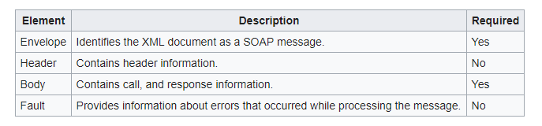
A SOAP message is an ordinary XML document containing the following elements:

Slide 12
Skeleton SOAP Message:
<?xml version="1.0"?> <soap:Envelope xmlns:soap="http://www.w3.org/2001/12/soap-envelope" soap:encodingStyle="http://www.w3.org/2001/12/soap-encoding"> <soap:Header> ... </soap:Header> <soap:Body> ... <soap:Fault> ... </soap:Fault> </soap:Body> </soap:Envelope>
The namespace defines the Envelope as a SOAP Envelope.
The encoding-Style attribute is used to define the data types used in the document.
The optional SOAP Header element contains application-specific information (like authentication, payment, etc) about the SOAP message.

Slide 13
SOAP Request Example:
The required SOAP Body element contains the actual SOAP message intended for the ultimate endpoint of the message.
Example
<?xml version="1.0"?> <soap:Envelope xmlns:soap="http://www.w3.org/2001/12/soap-envelope" soap:encodingStyle="http://www.w3.org/2001/12/soap-encoding"> <soap:Body> <m:GetPrice xmlns:m="http://www.w3schools.com/prices"> <m:Item>Apples</m:Item> </m:GetPrice> </soap:Body> </soap:Envelope>

Slide 14
SOAP Response Example:
A SOAP response could look something like this:
<?xml version="1.0"?>
<soap:Envelope xmlns:soap="http://www.w3.org/2001/12/soap-envelope" soap:encodingStyle="http://www.w3.org/2001/12/soap-encoding"> <soap:Body> <m:GetPriceResponse xmlns:m="http://www.w3schools.com/prices"> <m:Price>1.90</m:Price> </m:GetPriceResponse> </soap:Body>
</soap:Envelope>

Slide 15
REpresentational State Transfer (REST):
REST is the newcomer to the blocks.
Many developers found SOAP bulky and hard to use. For example, working with SOAP in JavaScript means writing a lot of code to perform extremely simple tasks because you must create the required XML structure absolutely every time.
REST provides a lighter weight alternative.
Instead of using XML to make a request, REST relies on a simple URL in many cases.
Both SOAP and REST rely on well-established rules that everyone has agreed to abide by in the interest of exchanging information.
REST can use four different HTTP 1.1 verbs (GET, POST, PUT, and DELETE) to perform tasks.

Slide 16
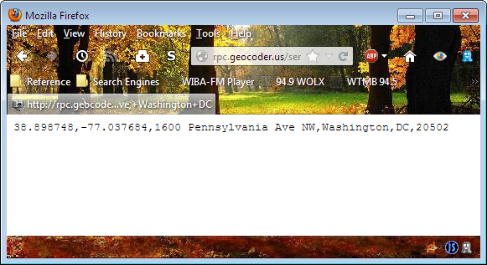
Viewing the REST Example
Sometimes, simple is best. In this case, REST is about as simple as it gets because all you need is an URL:
Open your browser and type
http://rpc.geocoder.us/service/csv?address=1600+Pennsylvania+Ave,+Washington+DC address field.
Press Enter. You’ll see the output in your browser in CSV format:

Slide 17
SOAP vs REST Differences:
REST is more dynamic, no need for creating and updating UDDI. (UDDI is an XML-based standard for describing, publishing, and finding web services. UDDI stands for Universal Description, Discovery, and Integration.)
REST is not restricted to XML format. REST web services can send plain text.
REST, unlike SOAP is not a protocol.
REST is protocol independent. A RESTful architecture may use HTTP, FTP or SOAP as the underlying communication protocol.
REST is an architectural style and a design for network-based software architectures.

